Slide 1
This session is being recorded
Webinar – 7 May 2026

Slide 3
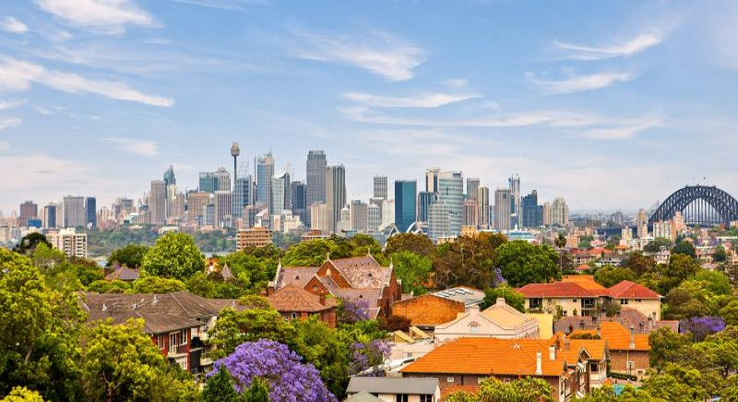
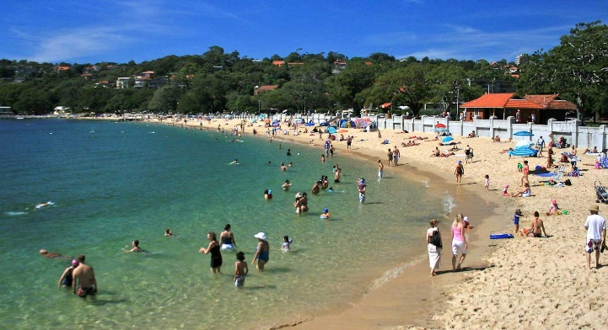

Panelist introductions
Mosman Council
Clr Ann Marie Kimber, Mayor
Craig Covich, General Manager
Vivienne Albin, Director Environment and Planning
Sarah Wallace, Team Coordinator Urban Planning
SJB
Jonathan Knapp, Director
Lulu Vitorelli, Associate Urban Designer ulu Vitorelli, Associate Urban Designer

Slide 4
Agenda
Project background and context 10 min
Mosman Masterplan introduction 30 min
Q&A panel session 60 min
How to have your say 5 min

Slide 5
Housekeeping
Q&A panel session
Submit questions through Q&A button in Zoom toolbar
This is a public forum, so please be respectful
To turn on closed captioning use the CC button in Zoom toolbar

Slide 6
Project background and context

Slide 7
Our role in Sydney's growth
Need for housing in Sydney and Mosman Council committed to providing its share of homes
NSW Government policies to facilitate dwelling delivery
​Low Mid-Rise Housing Policy (LMR)
LMR broad brush and excludes commercially zoned centre
LMR sparked a rush of developer interest in Mosman
‘One-size-fits-all’ approach - community concerns pressures on infrastructure, local character impacts, heritage and environmental effects

Slide 8
Our role in Sydney's growth
Council secured agreement late 2025 to prepare Mosman Masterplan - reshape LMR density
Placed-based masterplan so future growth reflects local priorities, infrastructure needs, and unique character
Agreement reached on possible LMR dwelling capacity
Commitment to retain 4,700 dwelling capacity –
Masterplan
LMR

Slide 9
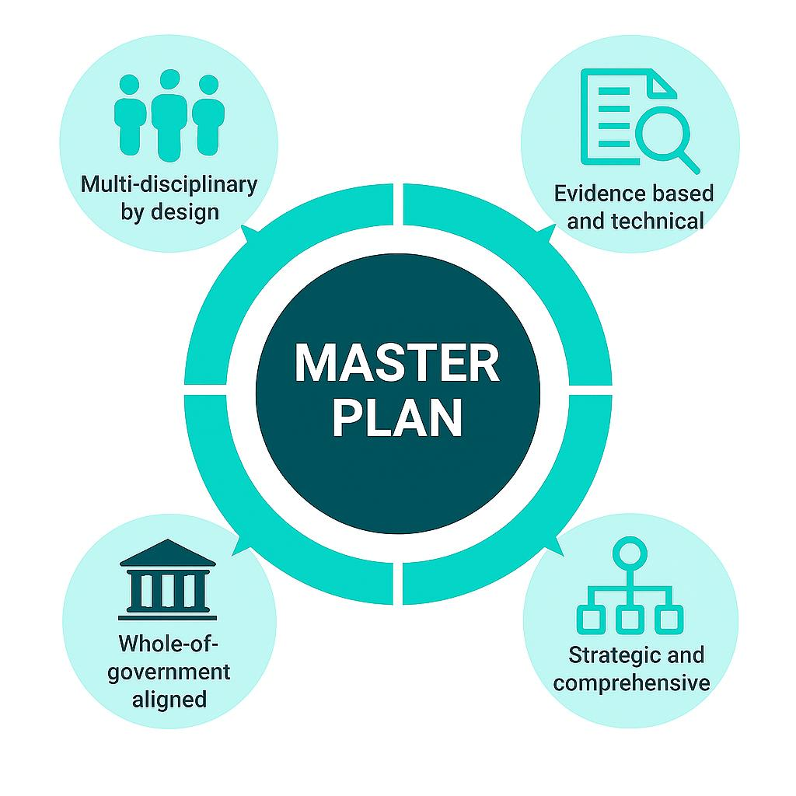
What is included in a masterplan
Notes:
Multi‑disciplinary by design: A master plan brings together urban design, land use planning, heritage, traffic and transport, infrastructure, and environmental studies.
Evidence‑based and technical: It is underpinned by detailed specialist reports (e.g. traffic, economic, social and heritage studies), not a single consultant’s opinion.
Whole‑of‑government input: A council‑prepared master plan reflects input from multiple internal teams, state agencies, service authorities and stakeholders.
Strategic and comprehensive: It integrates many documents into one coordinated framework to guide long‑term decision‑making, not a simple site‑based assessment.

Slide 10
What is included in a masterplan
Mosman Masterplan
Planning SJB
Affordable Housing Atlas Economics
Urban Design SJB
Economic Feasibility Savills
Traffic Fernway Engineering
Civic Centre Precinct Plan Archer Office
Heritage NBRS
Infrastructure SGS

Slide 11
Positive
community outcomes
A masterplan is a rare chance to plan for the future, to manage growth, avoid poor outcomes and improve liveability through better layouts, policy and developer contributions.
Increase affordable housing supply
Improved healthy cities objectives
Increase open space
Key sites renewal
Strengthened retail and commercial
Civic precinct and Council site opportunities
Embedded sustainability
Better access to transport
Improved future social infrastructure

Slide 12
Steps in the process
1 | Place understanding and housing capacity analysis | Council
2 | Develop principles and options | Council
3 | Community consultation | Council
4 | Review consultation outcomes and Council endorse preferred option | Council
5 | Finalise the masterplan and Council endorse masterplan planning proposal | Council
6 | Gateway determination | NSW Government
7 | Formal public exhibition and post-exhibition review | Council
8 | Finalisation and published on legislation website – in effect | NSW Government

Slide 13
Mosman Masterplan

Slide 14
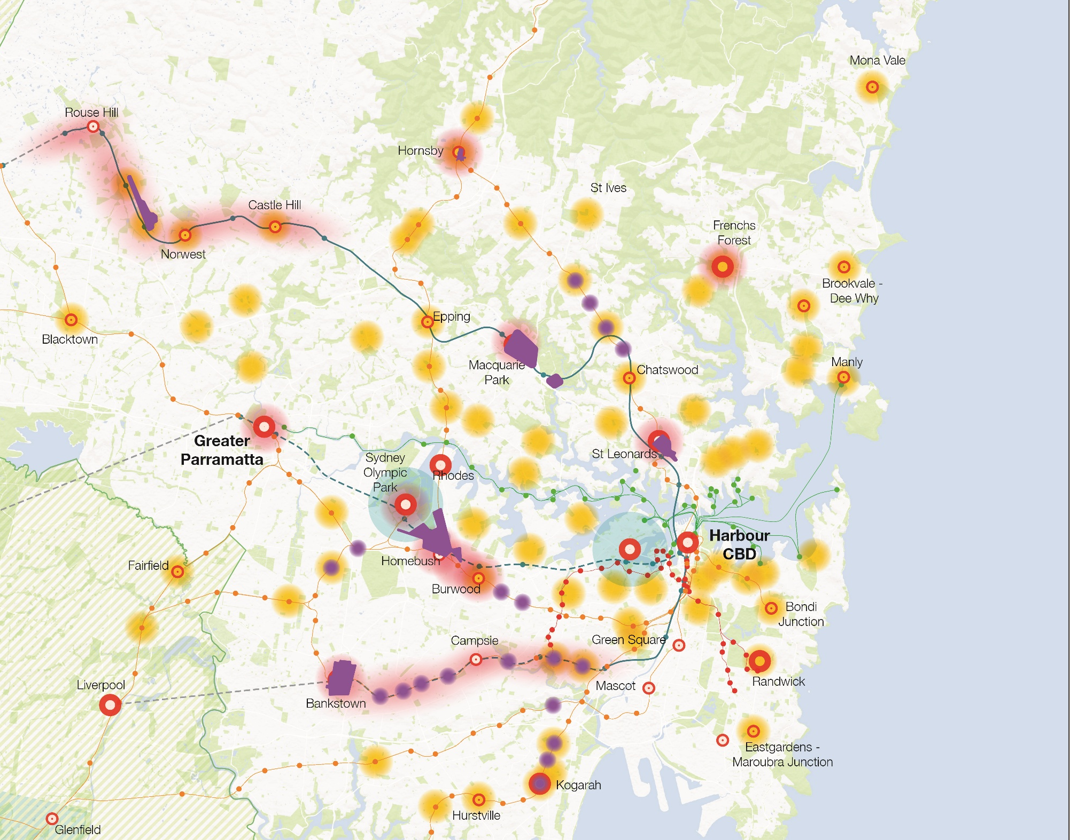
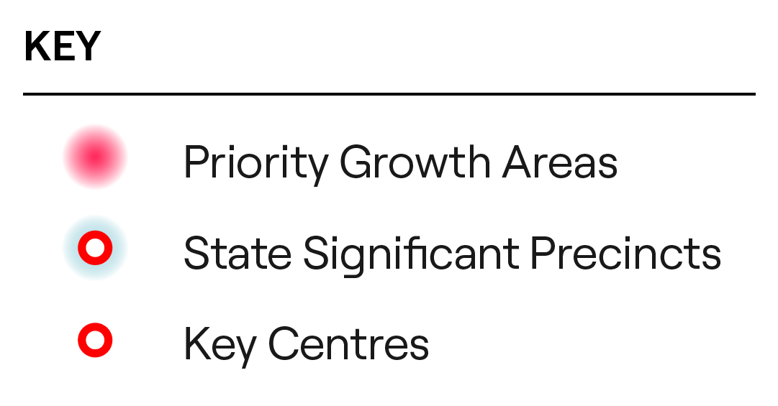


Sydney housing policies
Gordon
Killara
Lindfield
Roseville
Mosman
Only the LMR applies in Mosman

Slide 15
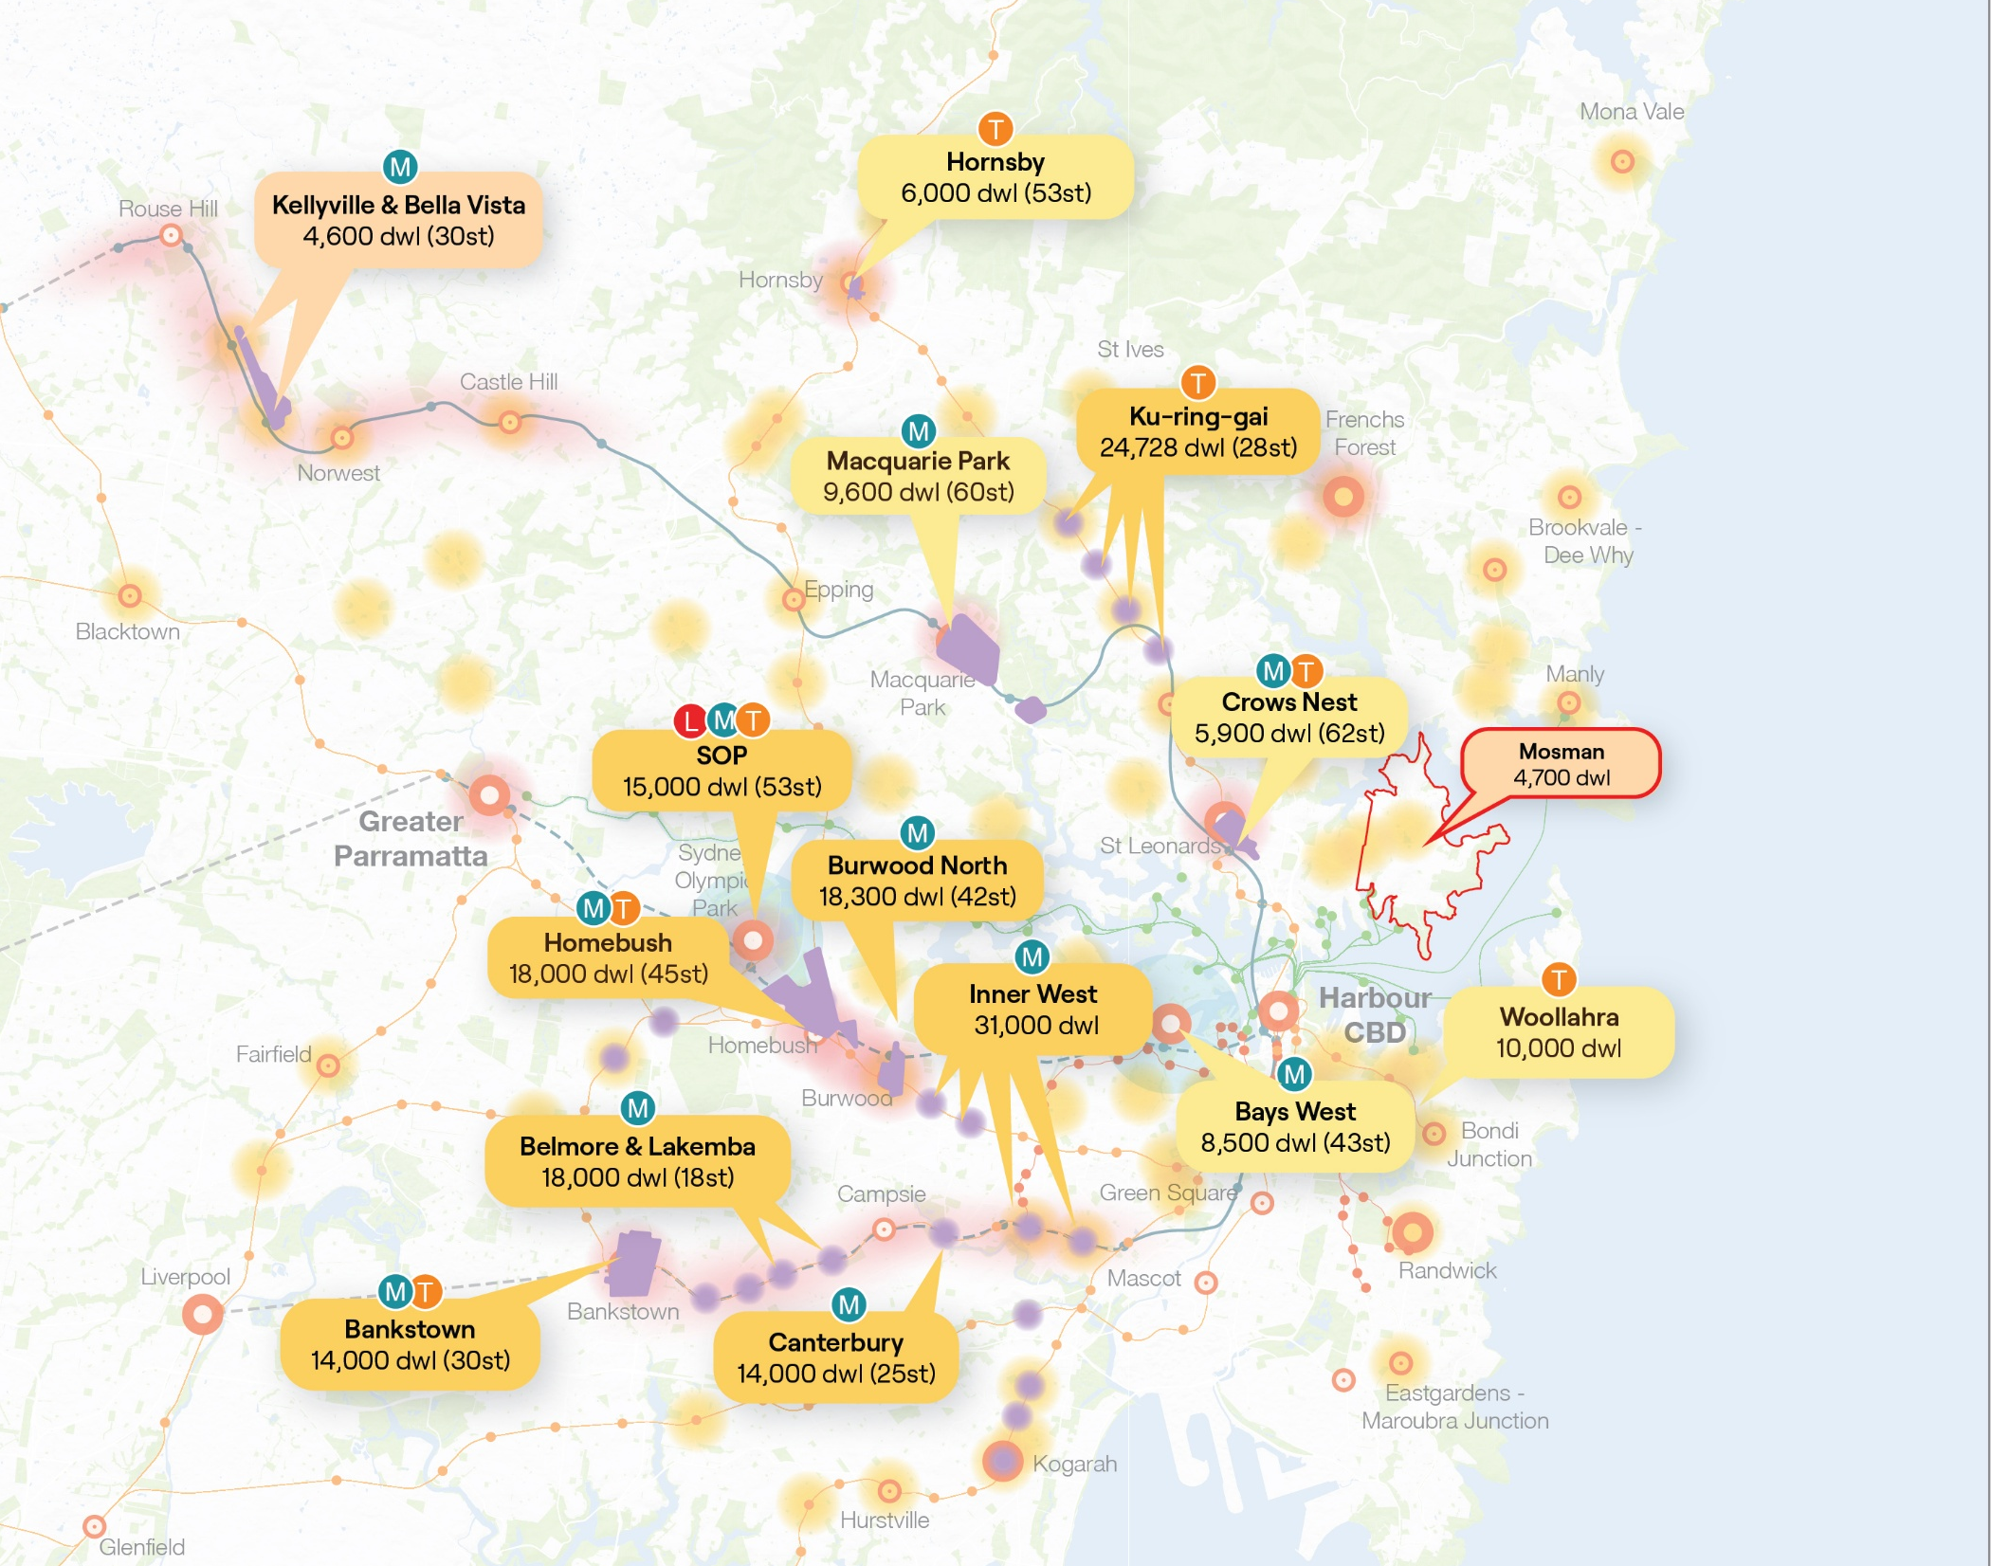
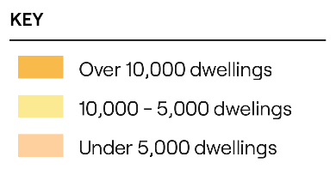
Recently announced dwellings

Slide 16
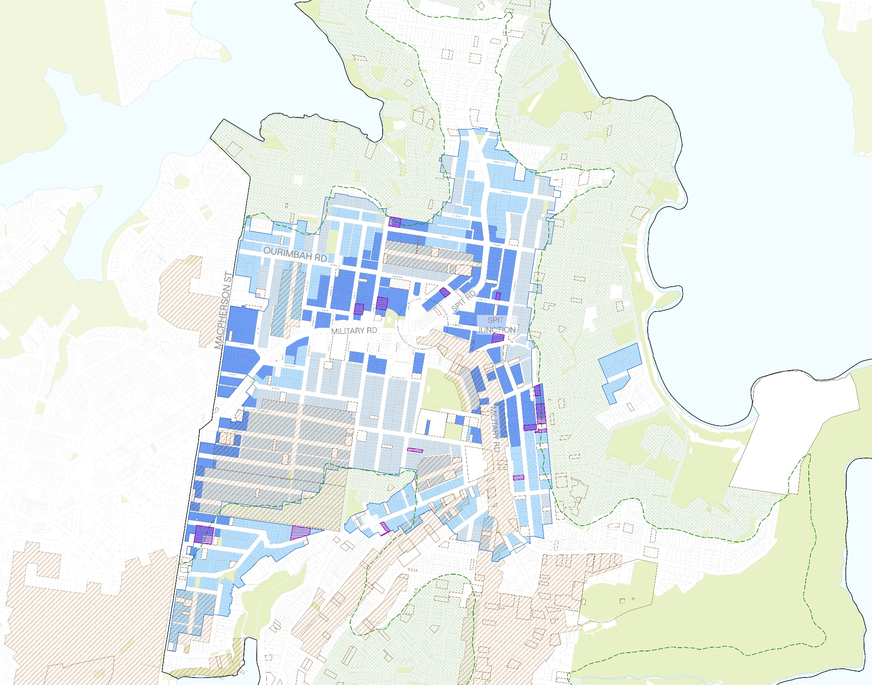
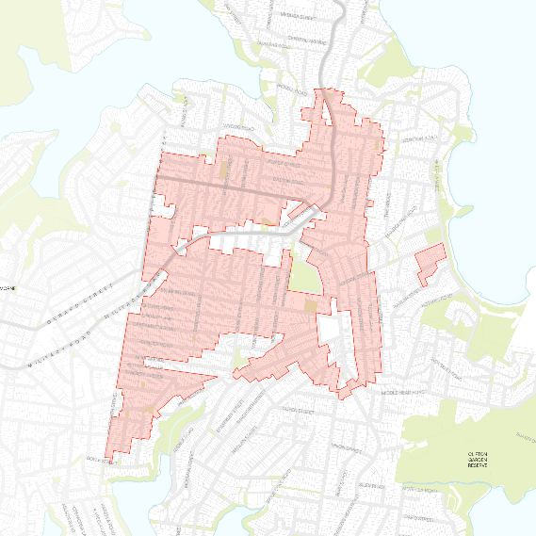
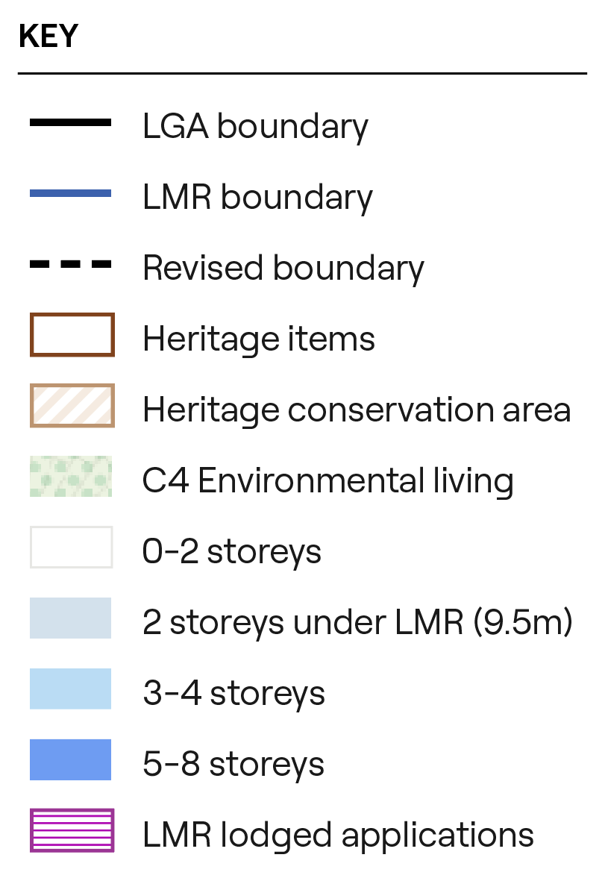
Mosman Low to Mid-Rise
EXTENT OF CHANGE
27%
Current LMR in Mosman
RFBs in R1 and R2 | RFBs in R3
0-800m from centre | 0-400m from centre | 400-800m from centre
FSR – max 0.8:1 | FSR – max 2.2:1 | FSR – max 1.5:1
HOB – max 9.5m | HOB – max 22m | HOB – max 17.5m
Storeys – 2 to 3 | Storeys – max 6 | Storeys – max 4

Slide 17
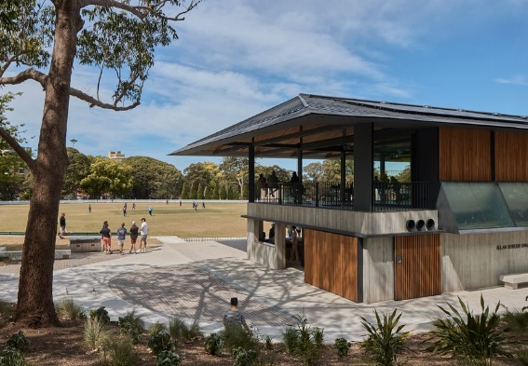
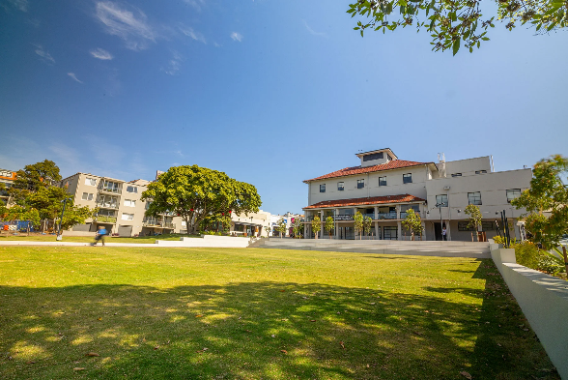

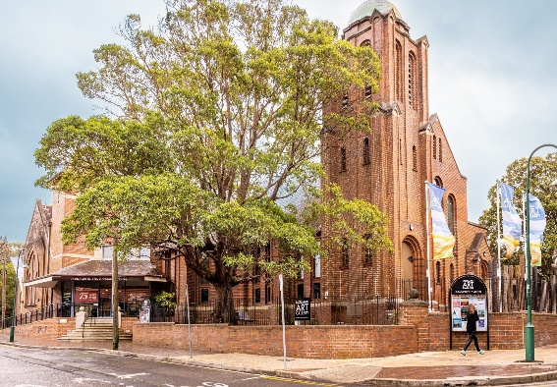
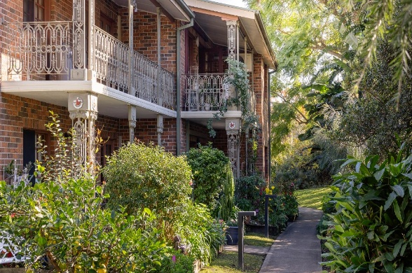
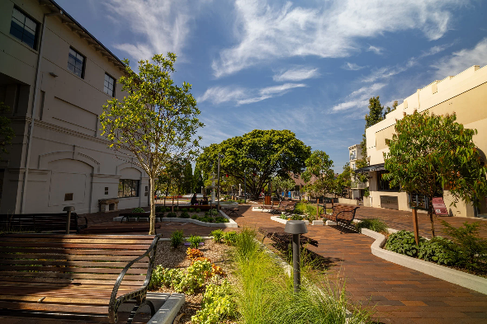
Mosman Vision
A vibrant, inclusive harbourside village where community and heritage are valued and where residents feel safe and connected.
Mosman’s Vision statement is from the MOSPLAN Community Strategic Plan 2025-2035.

Slide 18







Masterplan principles
Together, these principles help ensure future changes fit the local context, reflect community values and aspirations and lead to better social and environmental outcomes
Protect and enhance the established character
Celebrate heritage
Protect local amenity and liveability
Bring the community on the journey
Protect the environment
Advocate for community needs and infrastructure
Leverage value to deliver opportunities for all

Slide 19
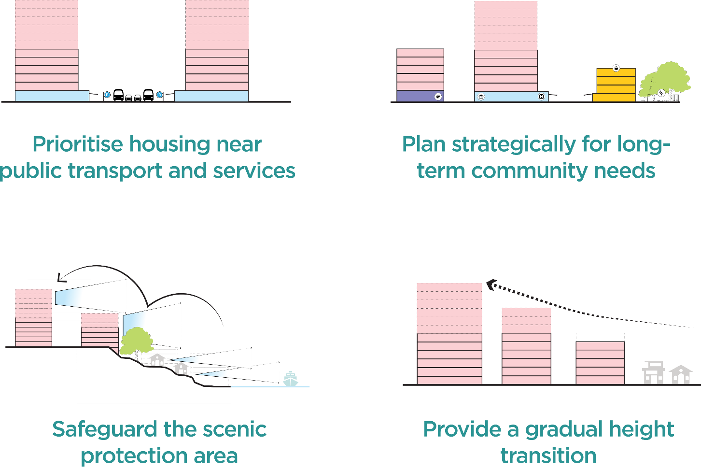
Masterplan drivers
Masterplan drivers have been developed to guide decisions on how growth is accommodated in Mosman

Slide 20
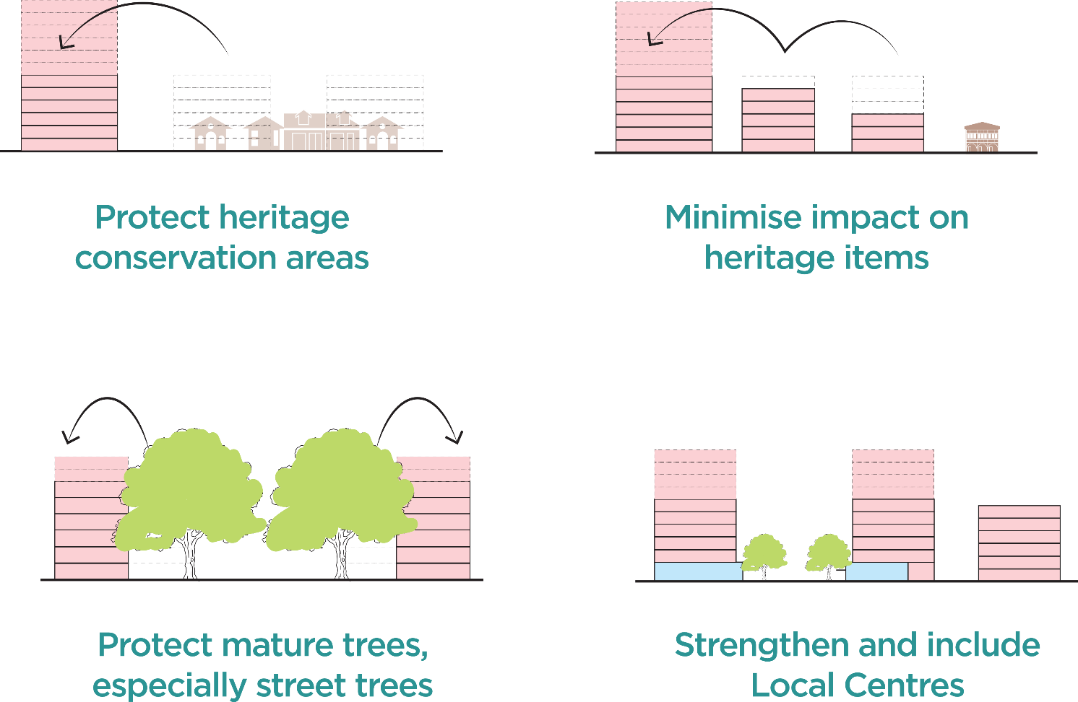
Masterplan drivers

Slide 21
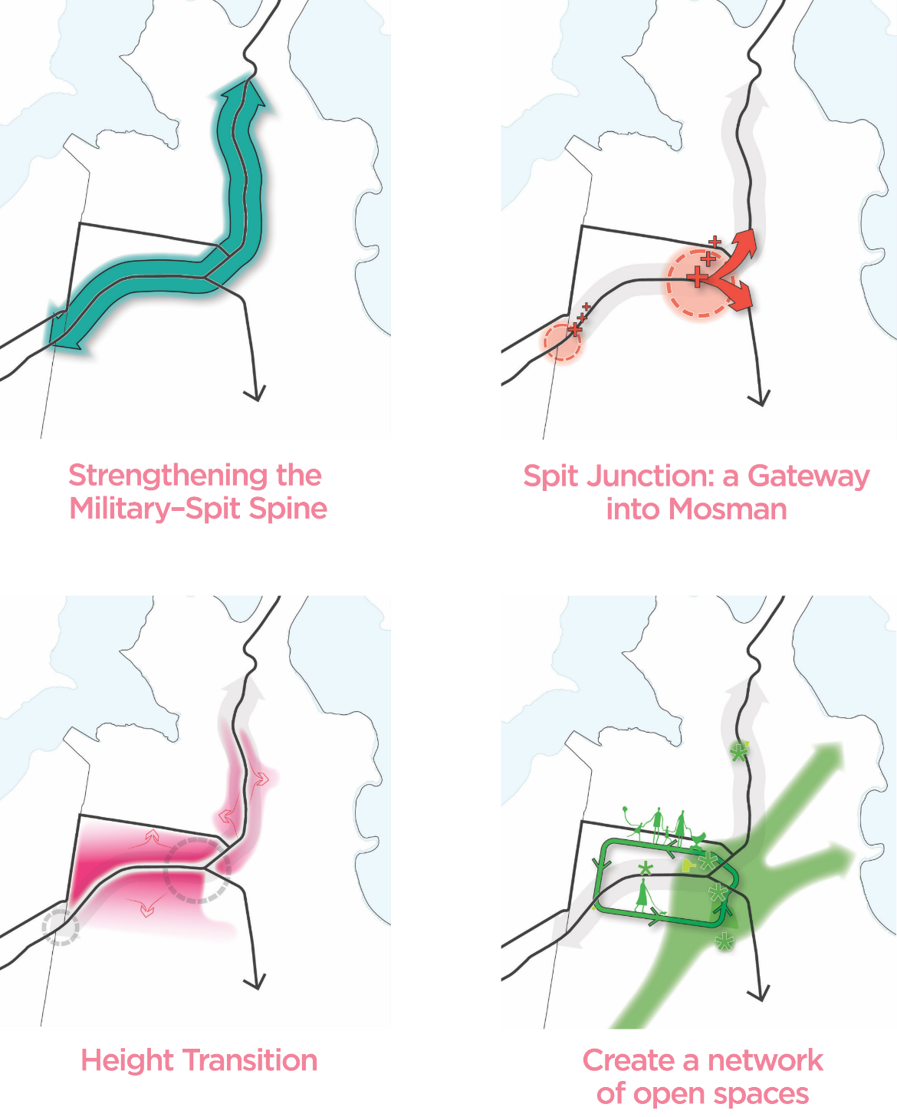
Strategic moves
The masterplan's design intent is captured through four strategic moves

Slide 22
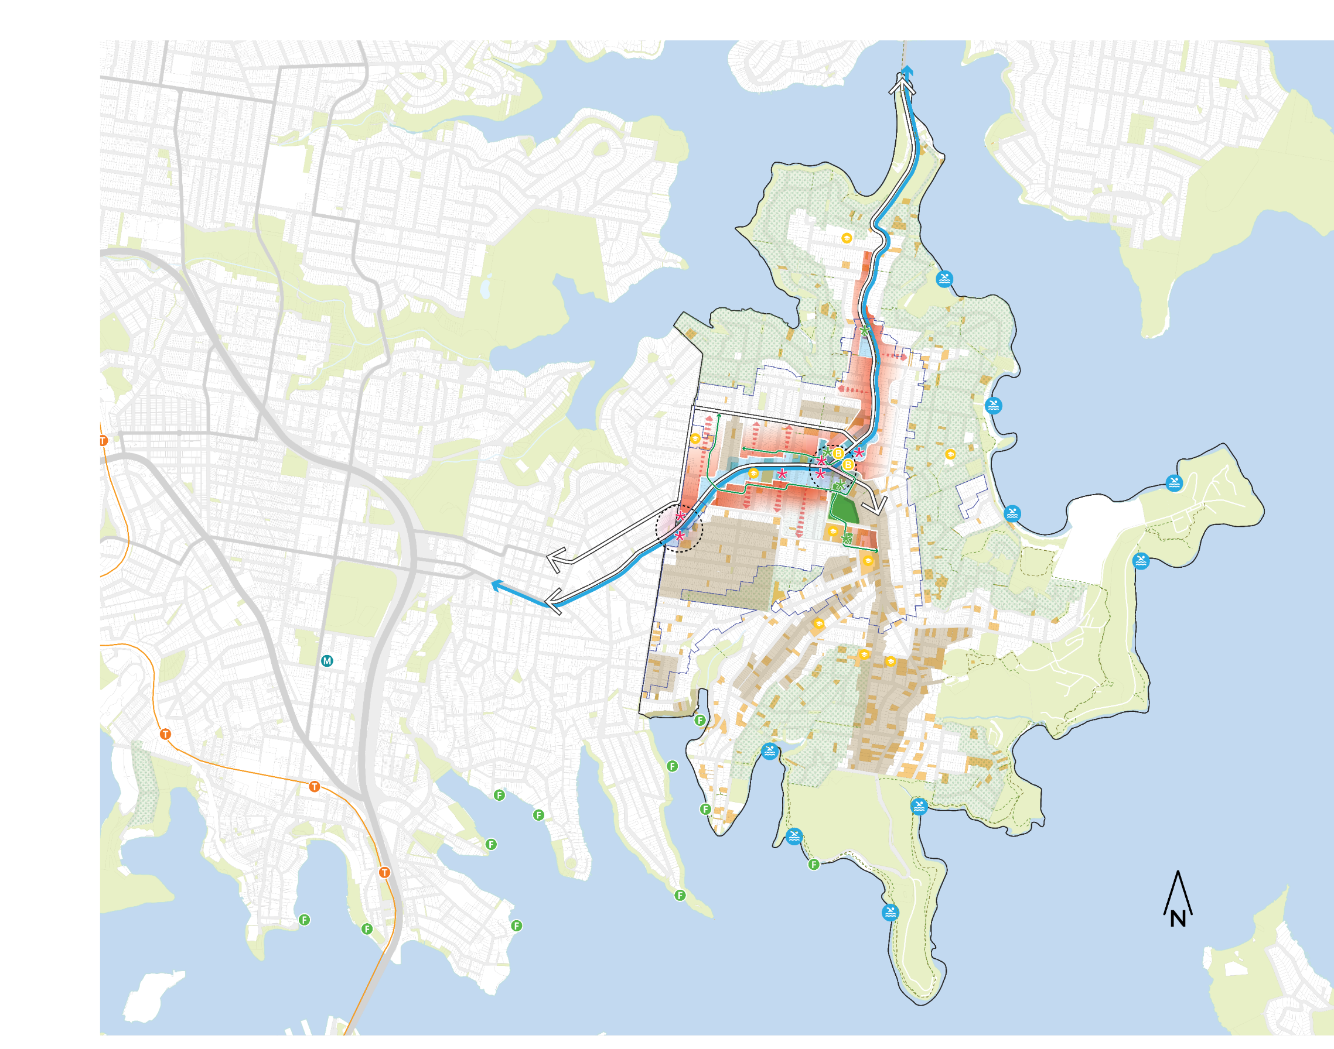
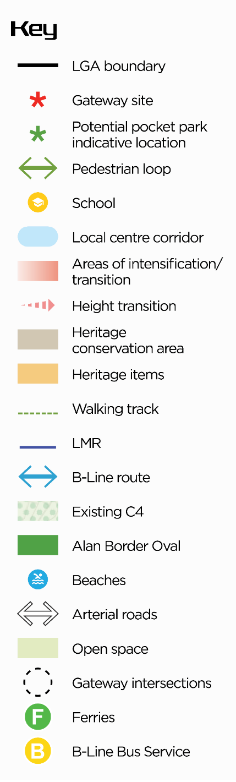
Our Approach
Mosman Concept Plan

Slide 23
Masterplan options

Slide 24
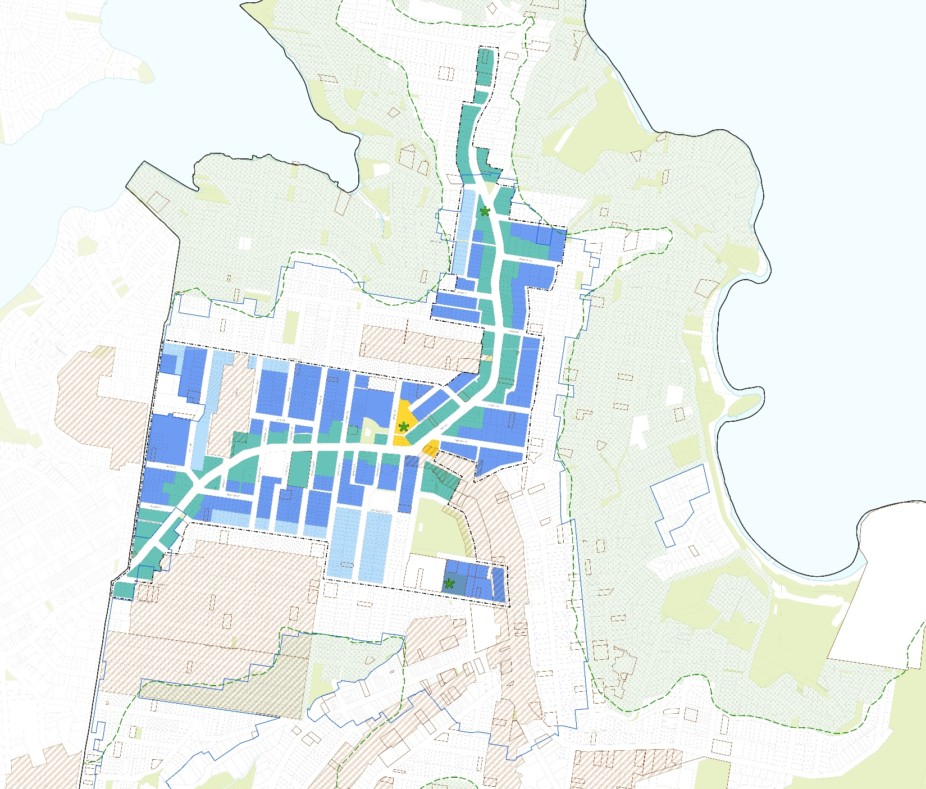
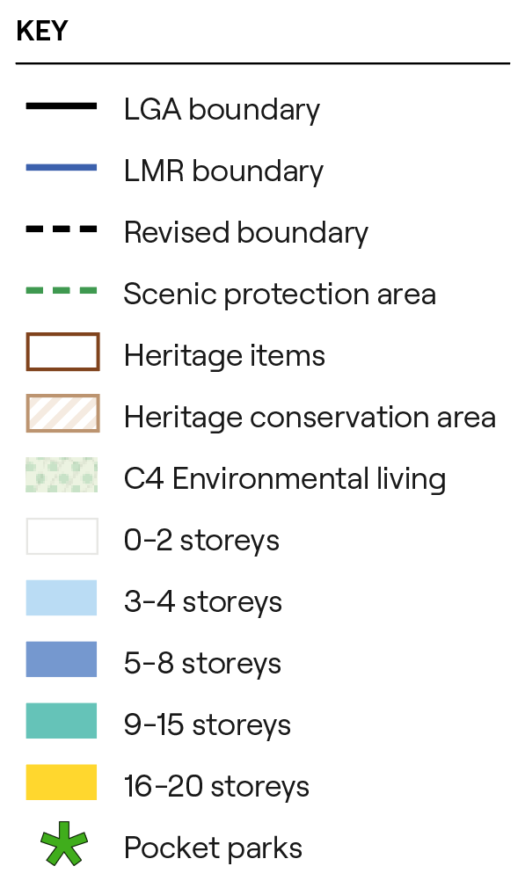
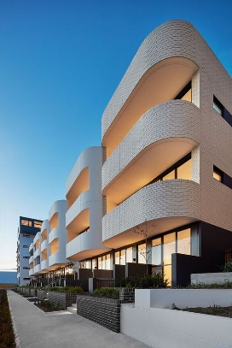
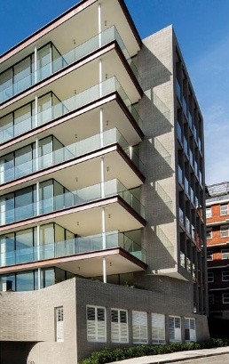
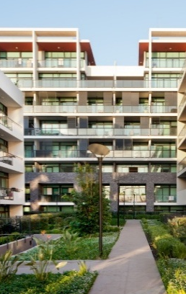
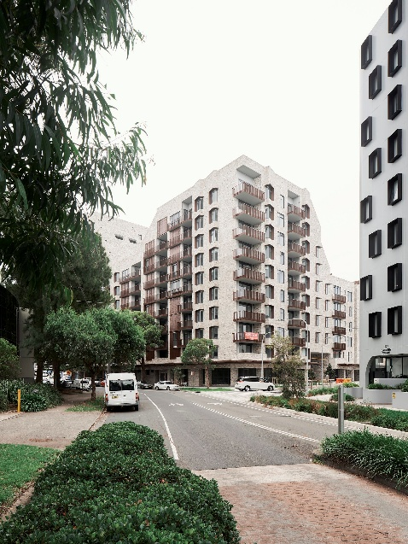
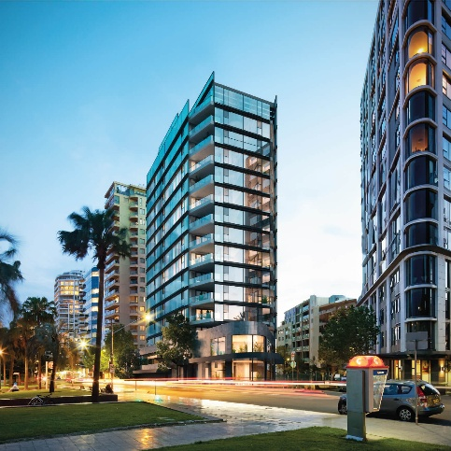
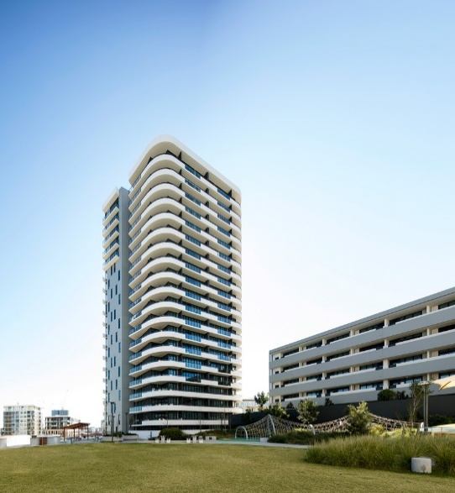
Option 1: Low and wide
MIDDLE HARBOUR
Indicative building forms
BALMORAL
4 storeys
6 storeys
8 storeys
10 storeys
15 storeys
20 storeys

Slide 25
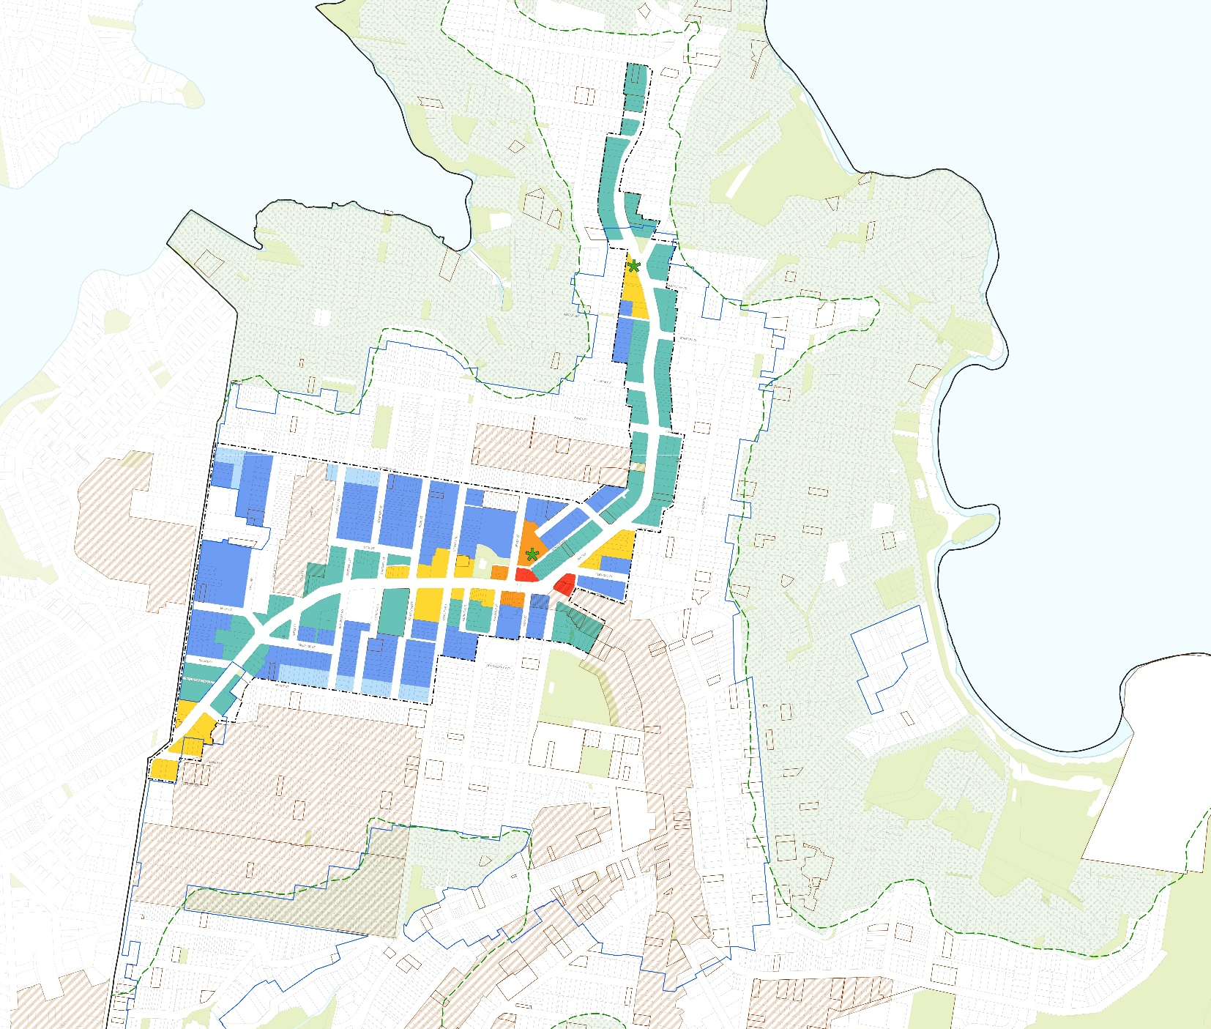
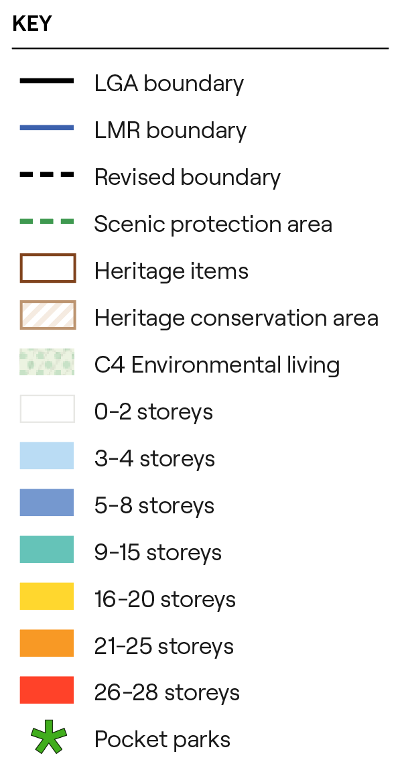
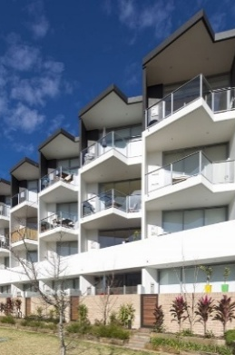

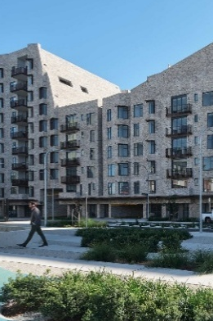
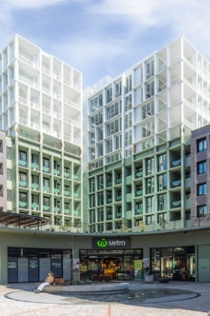
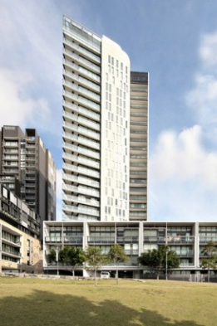
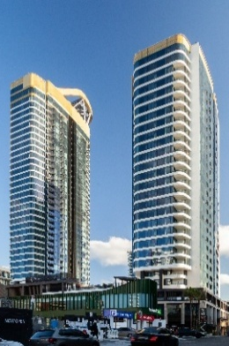
Option 2: High and narrow
MIDDLE HARBOUR
Indicative building forms
BALMORAL
4 storeys
6 storeys
12 storeys
18 storeys
22 storeys
28 storeys

Slide 26
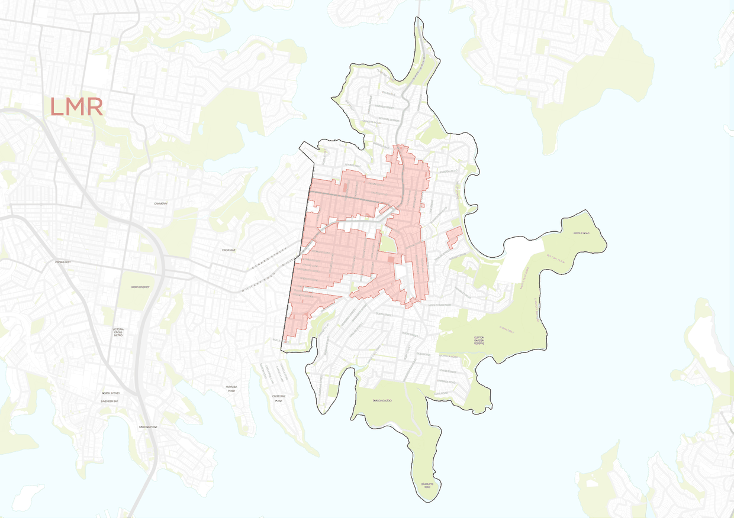
What are the differences between the options?

Slide 27
Q&A
Please submit your question through the Q&A box on your Zoom toolbar.

Slide 28
How to have your say

Slide 29
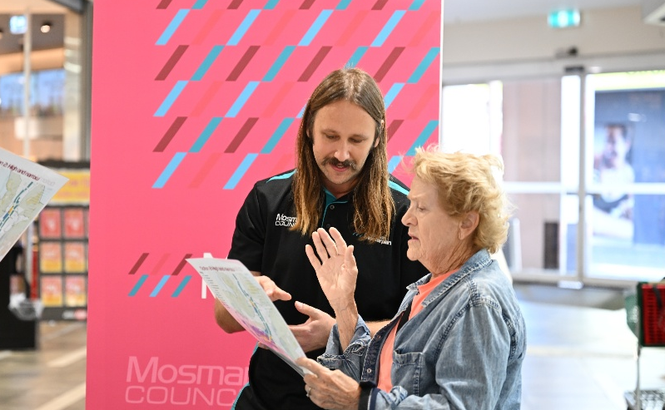
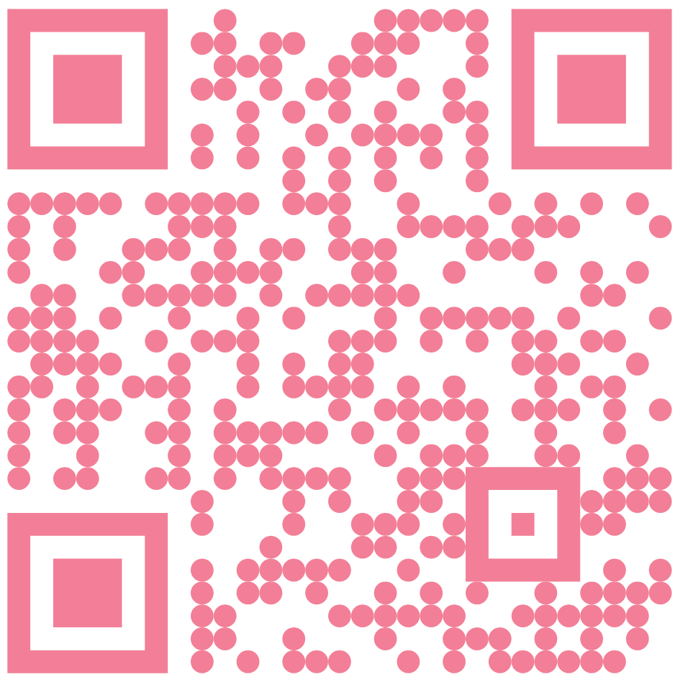


Engagement schedule
Mosman Market Pop-up – Saturday 1 May, 8am–3pm
Bridgepoint Centre Pop-up – Tuesday 5 May, 11am–1pm
Balmoral Tramshed Pop-up – Thursday 7 May, 7–9am
Online webinar – Thursday 7 May, 6pm–8pm
Allan Border Oval Pavilion Drop-in – Friday 8 May, 10am–1pm
Mosman Art Gallery Drop-in – Saturday 9 May, 1–4pm
Business Breakfast – Tuesday 12 May, 7.30–9am
Allan Border Oval Pavilion Drop-in – Tuesday 12 May, 4.30–7.30pm
Allan Border Oval Pavilion Drop-in – Thursday 14 May, 4.30–7.30pm
Consultation Closes – Tuesday 19 May 2026
We want your input – whether you live, work, study or run a business in Mosman. Share your ideas by Tuesday 19 May 2026.

